Slide 1

UNIVERSITY INSTITUTE OF ENGINEERING
DEPARTMENT OF AIT - CSE
Bachelor of Engineering (CSE)
Advanced Programming (20CST-337)
By: Rahul Rathore(E12904)
Lecture -7
Fibonacci numbers. Prime Numbers: Euler's theorem, Primality test, Integer factorization
DISCOVER . LEARN . EMPOWER

Slide 2
Chapter | Course Objectives
1. | This subject aims to focuses on Advanced concept of C++ and advanced data structure to students. It focuses on advanced level analysis of algorithm and computational mathematics.
Chapter | Course Outcomes
1. | Explain the data structure and OOPS concepts using C++. Apply the shortest path and minimum spanning algorithms in computer networks. Examine the complexity of searching and sorting algorithms, and optimization through arrays, linked structures, stacks, queues, trees, and graphs. Decide and implement an appropriate graph algorithm and hashing function in computer networks for data security. Construct security encryption and decryption algorithms using computational mathematics and graph algorithm.

Slide 3

Fibonacci Numbers
The Fibonacci sequence is defined as follows:
0,1,1,2,3,5,8,13,21,34,55,89,...

Slide 4



Properties
Fibonacci numbers possess a lot of interesting properties. Here are a few of them:
Cassini's identity:
The "addition" rule:
Applying the previous identity to the case k=n we get:
From this we can prove that for any positive integer k F_{nk} is multiple of F_{n}
The inverse is also true:if Fm is multiple of Fn, then m is multiple of n.
GCD identity:
GCD(Fm,Fn)=FGCD(m,n)

Slide 5
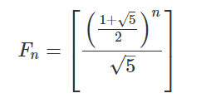
Formulas for the n-th Fibonacci number
The n-th Fibonacci number can be easily found in O(n) by computing the numbers one by one up to n. However, there are also faster ways, as we will see.
Closed-form expression
There is a formula known as "Binet's formula", even though it was already known by Moivre:

Slide 6
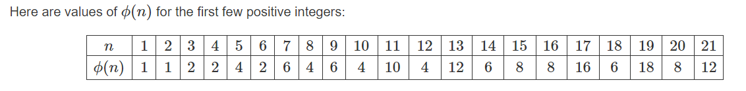
Euler's totient function
Euler's totient function, also known as phi-function ϕ(n), counts the number of integers between 1 and nn inclusive, which are coprime to n. Two numbers are coprime if their greatest common divisor equals 1 (1 is considered to be coprime to any number).

Slide 7
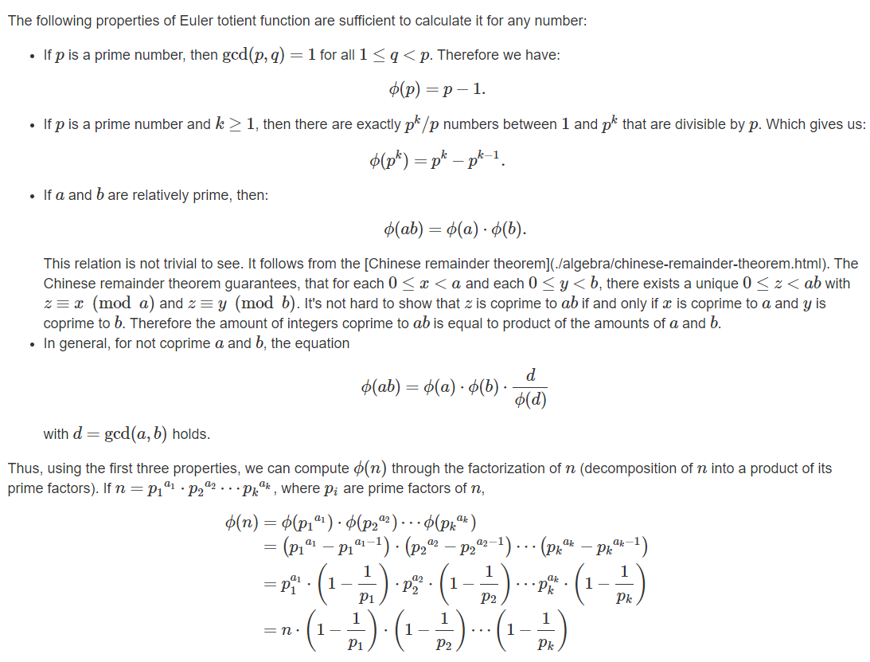
Properties

Slide 8
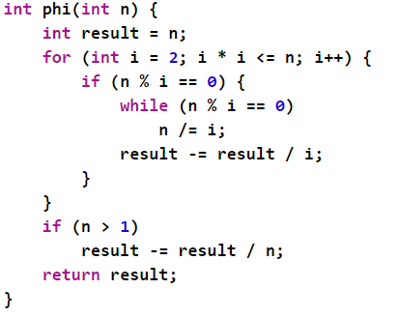
Implementation
Here is an implementation using factorization in O(√n):

Slide 9
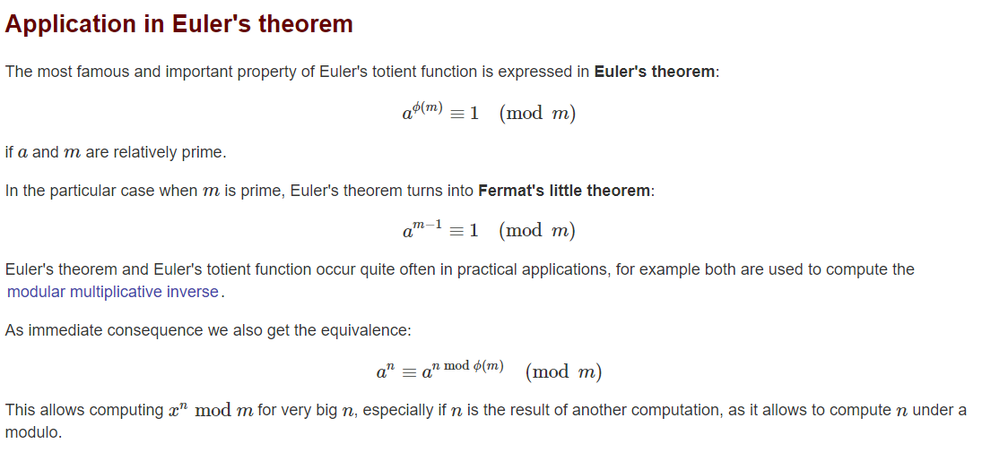

Slide 10
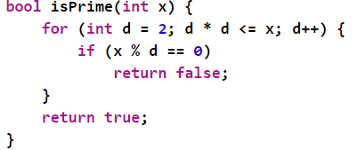
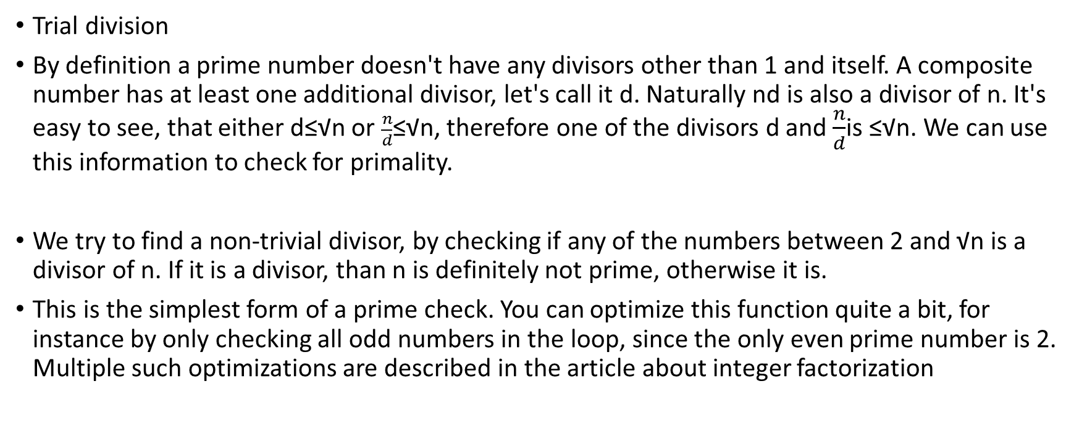
Primality tests
Trial division
By definition a prime number doesn't have any divisors other than 1 and itself. A composite number has at least one additional divisor, let's call it d. Naturally nd is also a divisor of n. It's easy to see, that either d≤√n or $\frac{n}{d}$≤√n, therefore one of the divisors d and $\frac{n}{d}$is ≤√n. We can use this information to check for primality.
We try to find a non-trivial divisor, by checking if any of the numbers between 2 and √n is a divisor of n. If it is a divisor, than n is definitely not prime, otherwise it is.
This is the simplest form of a prime check. You can optimize this function quite a bit, for instance by only checking all odd numbers in the loop, since the only even prime number is 2. Multiple such optimizations are described in the article about integer factorization

Slide 11
Fermat primality test
This is a probabilistic test.
Fermat's little theorem (see also Euler's totient function) states, that for a prime number p and a coprime integer a the following equation holds:
In general this theorem doesn't hold for composite numbers.
This can be used to create a primality test. We pick an integer 2≤a≤p−2, and check if the equation holds or not. If it doesn't hold, e.g. ap−1≢1modp, we know that p cannot be a prime number. In this case we call the base a a Fermat witness for the compositeness of p.
However it is also possible, that the equation holds for a composite number. So if the equation holds, we don't have a proof for primality. We only can say that p is probably prime. If it turns out that the number is actually composite, we call the base a a Fermat liar.
By running the test for all possible bases a, we can actually prove that a number is prime. However this is not done in practice, since this is a lot more effort that just doing trial division. Instead the test will be repeated multiple times with random choices for a. If we find no witness for the compositeness, it is very likely that the number is in fact prime.

Slide 12
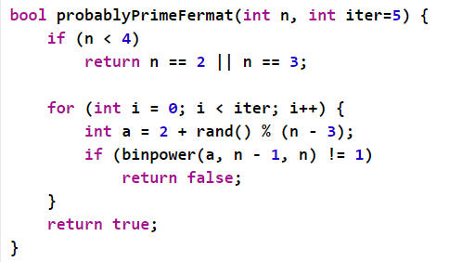
We use Binary Exponentiation to efficiently compute the power a^{p−1}.
The Fermat test is still be used in practice, as it is very fast and Carmichael numbers are very rare. E.g. there only exist 646 such numbers below 109.

Slide 13
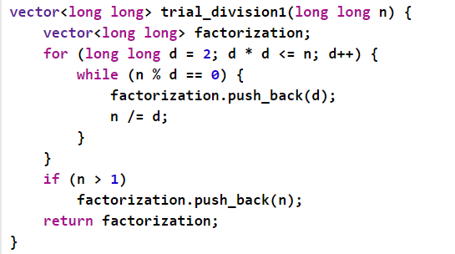
Integer factorization
Trial division
This is the most basic algorithm to find a prime factorization.
We divide by each possible divisor d. We can notice, that it is impossible that all prime factors of a composite number n are bigger than √n. Therefore, we only need to test the divisors 2≤d≤√n, which gives us the prime factorization in O(√n).
The smallest divisor has to be a prime number. We remove the factor from the number, and repeat the process. If we cannot find any divisor in the range [2; √n], then the number itself has to be prime.

Slide 14
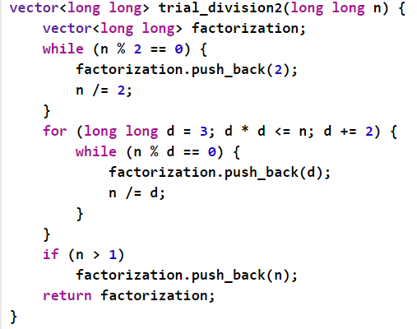
Wheel factorization
This is an optimization of the trial division. The idea is the following. Once we know that the number is not divisible by 2, we don't need to check every other even number. This leaves us with only 50% of the numbers to check. After checking 2, we can simply start with 3 and skip every other number.

Slide 15
THANK YOU

